Slide 1
Which Two Cities Are Similar?
By Firdhous Puraliyil

Slide 2
INDEX
INTRODUCTION
DATA
ANALYSIS
RESULTS

Slide 3
Introduction
Problem Statement: I am a data analyst that is trying to help people see which two cities out of Austin, Chicago and Seattle are similar
Background: I have always wondered which cities are similar and which are not. I always thought Austin and Seattle were the most similar. Let’s test it out
Audience: To anyone who has a curious interest in which two cities are similar out of Austin, Chicago and Seattle

Slide 4
Data
The following categories are what we used to measure similarity among cities:
Census
Cost of Living
Health
Venue (Foursquare API)
Weather

Slide 5
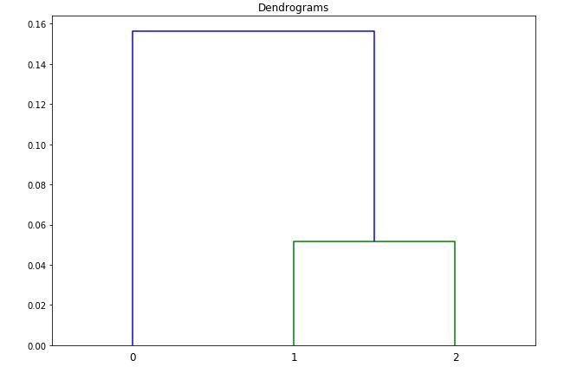
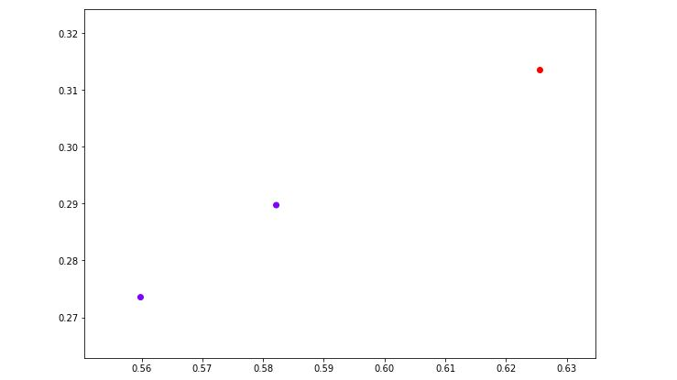
Analysis (Census)
0 is Austin, 1 is Chicago, and 2 is Seattle

Slide 6
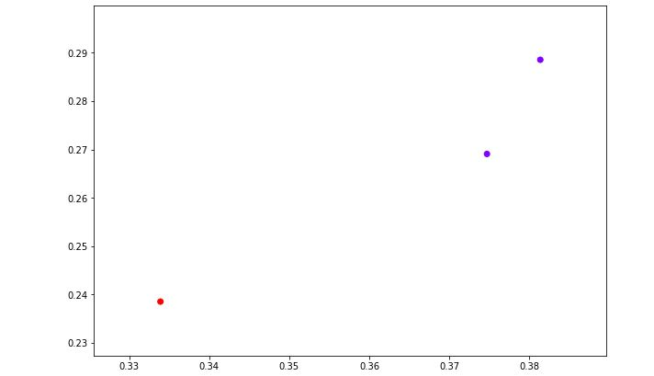
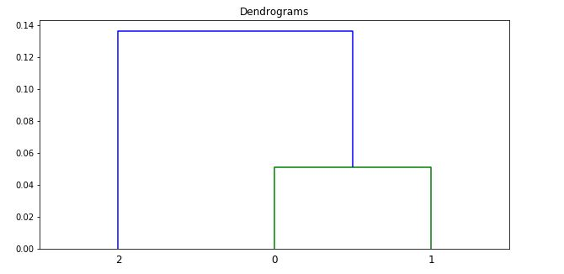
Analysis (Cost of Living)
0 is Seattle, 1 is Chicago, and 2 is Austin

Slide 7
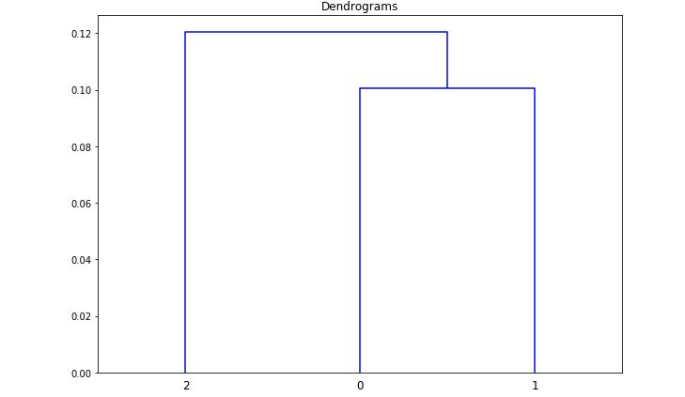
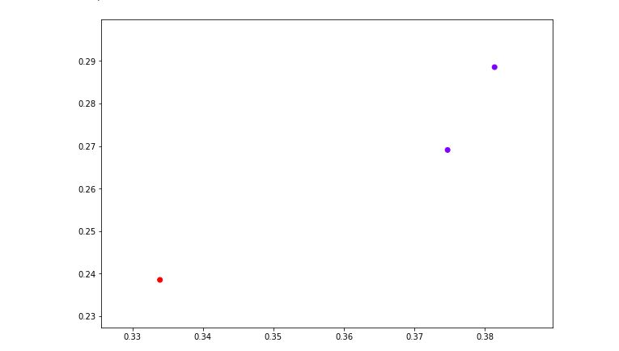
Analysis (Health)
0 is Chicago, 1 is Austin, and 2 is Seattle

Slide 8
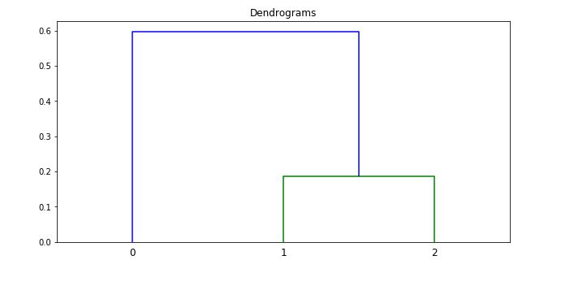
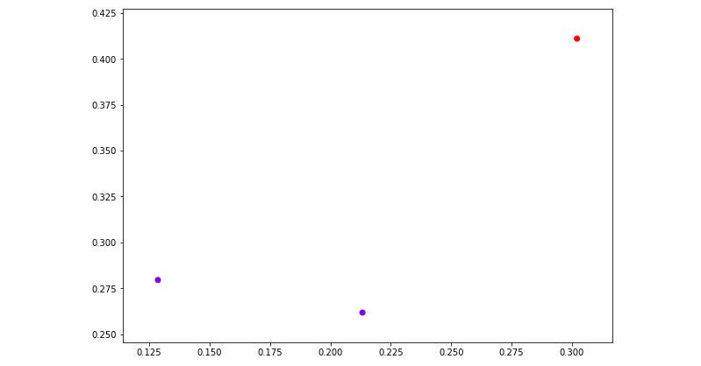
Analysis (Venue)
0 is Austin, 1 is Chicago, and 2 is Seattle

Slide 9
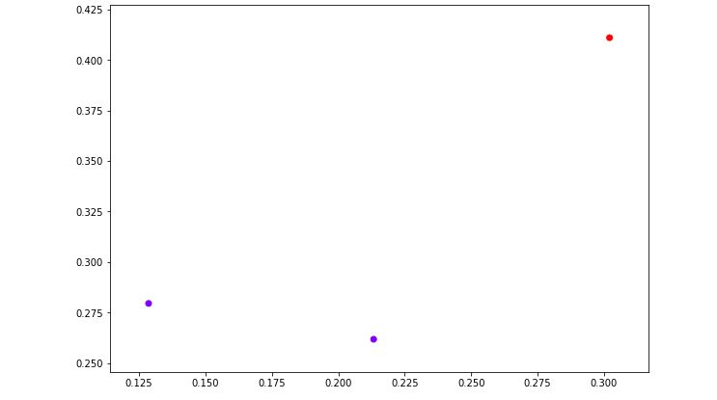
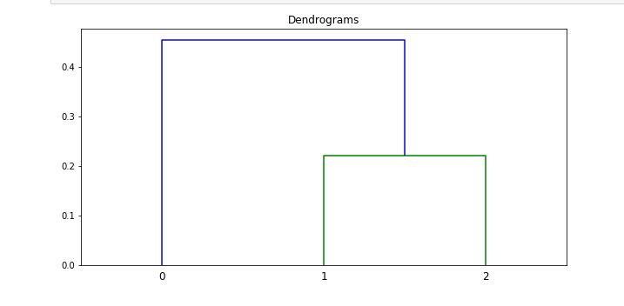
Analysis (Weather)
0 is Austin, 1 is Chicago, and 2 is Seattle

Slide 10
Results
Cities | Category Similarity
Austin - Chicago | 1
Austin - Seattle | 0
Chicago - Seattle | 4

Slide 11
Results (Continued)
From the Exploratory Analysis we can conclude that Chicago and Seattle have the most in common with 4 categories
Austin and Seattle are not similar in any way when Chicago is also added for comparison
Doesn’t necessarily mean that they are similar, only our data says that
Out of the three cities, Chicago and Seattle are the most similar

